Slide 1
INVESTMENT CASE STUDY SUBMISSION
Group Name:
Aditya Vikram Singh
Sarnav Rekhi
Nilamber
Anukrit

Slide 2
ABSTRACT
Spark Funds wants to make investments in a few companies. So we have explained the global trends in investments so that company can take the investment decisions effectively. The analysis will give detail information as which are the funding round type where the company should invest based on their investment budget. Also, we have provided data for the top English speaking countries receiving the highest funding and where the company can invest. We have also highlighted the sector which is best suited for the company based on the current trend.

Slide 3
Flow chart for making the analysis
Start
Stop
Plotting
Data Cleaning
Sector Analysis 2
Funding Type Analysis
Country Analysis
Sector Analysis 1
Funding Type Analysis

Slide 4
Analysis for funding type
For an investment range between 5 million to 15 million, venture funding round type will be the best suited for company to make investment
The average funding amount for Venture type is 12 millions (approximately)

Slide 5
Top 3 English speaking countries
The top 3 English Speaking countries where the company can invest are as follow:
USA
Great Britain
India

Slide 6
Best sector to invest for company

Slide 7
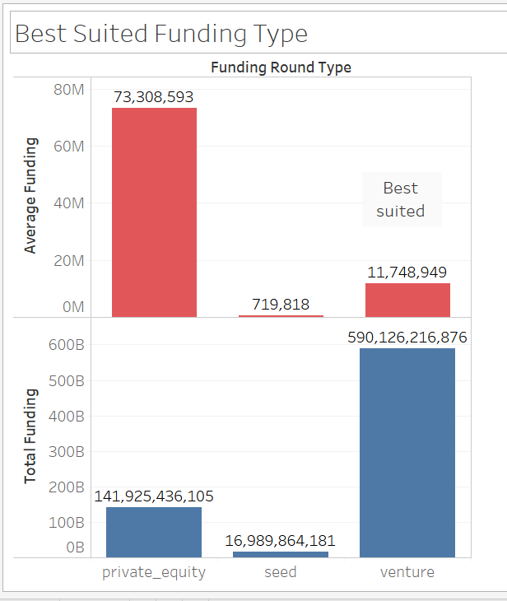
Average and Total Funding for specific funding type
Average Funding (in millions)
Total funding (in billions)
For company invest between 5 to 15 million USD, Venture funding type will be the best suited option.

Slide 8
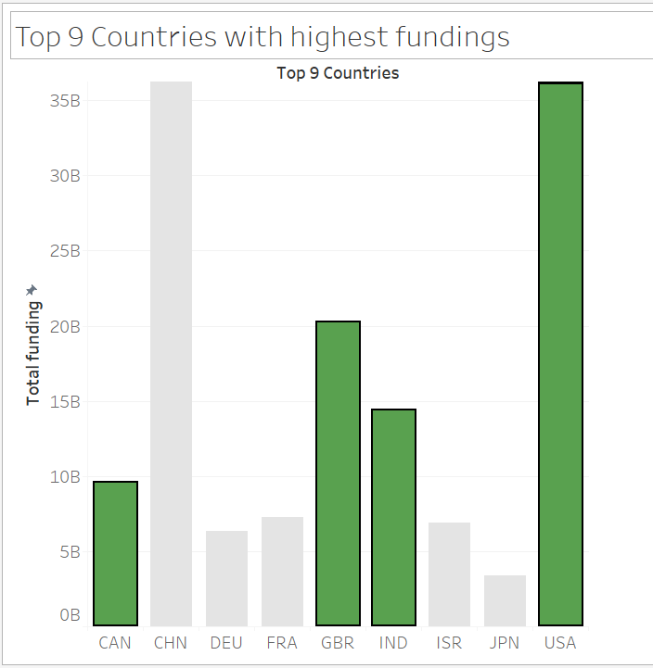
Top 9 Countries and the total funding received
List of English Speaking Countries
List of Non- English Speaking Countries

Slide 9
<Results>
Plot 3

Slide 10
Conclusion
Here are some key points from the analysis made:
For an investment range between 5 million to 15 million, venture funding round type will be the best suited for company to make investment
The average funding amount for Venture type is 12 millions (approximately)
The top 3 English Speaking countries where the company can invest are as follow:
USA
Great Britain
India

